Slide 1

Automatic Creation of concept map
Department of Computer Science
Rollwala Computer Centre
Presented by :-
Hardik Raja (24)
Pawan Dewani (36) Under the guidance of
Henil Mananiya (39) Dr. Maitri Jhaveri

Slide 2
Introduction
Concept maps are graphical tools for the representation and construction of knowledge.
It is a dynamic and flexible graphical representation composed of concepts and relationships is considered easier to be understood than a complex text.
It is an effective means to take notes and brainstorm essay topics. It shows relationship between two entities and one can easily know the main concepts of the subjects before plunging deeply into the text.

Slide 3
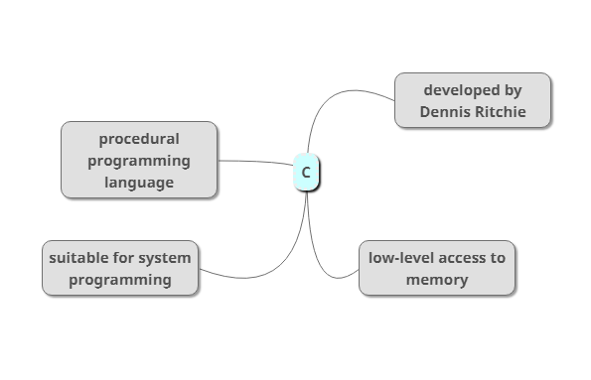
Example of Concept Map
C is a procedural programming language. It was initially developed by Dennis Ritchie between 1969 and 1973. It was mainly developed as a system programming language to write an operating system. The main features of C language include low-level access to memory, a simple set of keywords, and clean style, these features make C language suitable for system programming like an operating system or compiler development

Slide 4
Project Profile
Input : Text File
Output : Directed Graph
Technique : Ruled-based NLP with
[Added feature: Co-reference resolution]

Slide 5
Literature Survey-Tools

Slide 6
Tools currently available
Tool Name | Feature
Tobloef.com[1] | A GitHub project which takes input in text and forms mindmap by using indentation of text.
Mindmup.com[2] | Web based tool that provides drag and drop interface to create root and child nodes and also provides cloud storage.
Mindmeister[3] | One of the most widely used tool and more than 10 million people use it. Provides different templates, purpose based mind-mapping(like business, brainstorming) and one can also publish their mindmap.
Ayoa Mind Mapping Tool[4] | It is a visual work management app inspired by science that utilizes multi-visual approach and used by Harvard, BBC, Disney, Coco-Cola.

Slide 7
Tools currently available cont.
Tool Name | Feature
Mindly[5] | Mobile App Tool that provides central node and lets you add text, icons, colors and add idea in the next outer layer.
SmartDraw[6] | Used for linear mind-mapping. Root node starts at left side and add each subsequent ideas from left to right.
Storm Board[7] | Web based tool for In person mind-mapping sessions. Uses sticky notes rather than nodes and helps people collaborately create tasks, add votes to ideas, etc.

Slide 8
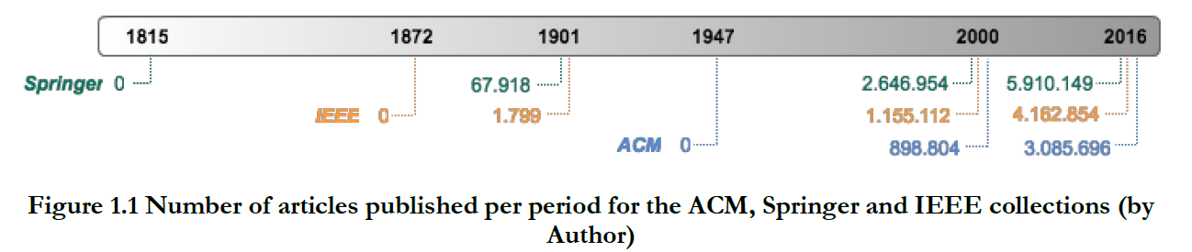
Need for automatic creation of concept map
According to the EMC digital universe study, it is estimated that 1 septillion (10^42) bits of information were produced in the year 2014 and the expectation is that this number will be multiplied by 6 until the year 2020.
From the study, we can observe that the number of articles published in the last sixteen years is higher than in the last century.
The manual construction of a concept map requires a certain dedication of time and effort engaged in the identification and structuring of knowledge.

Slide 9
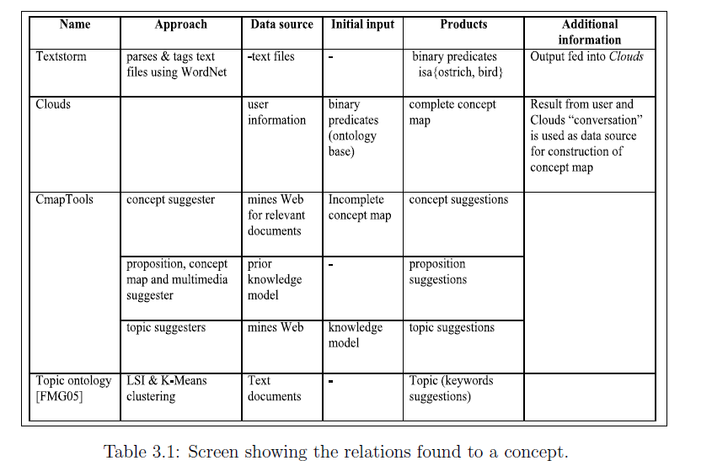
Comparison of tools(semi-automatic)[11]

Slide 10
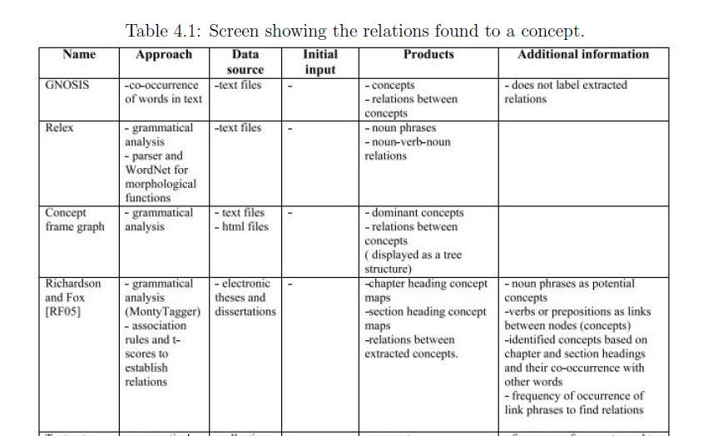
Comparison of tools[11]

Slide 11
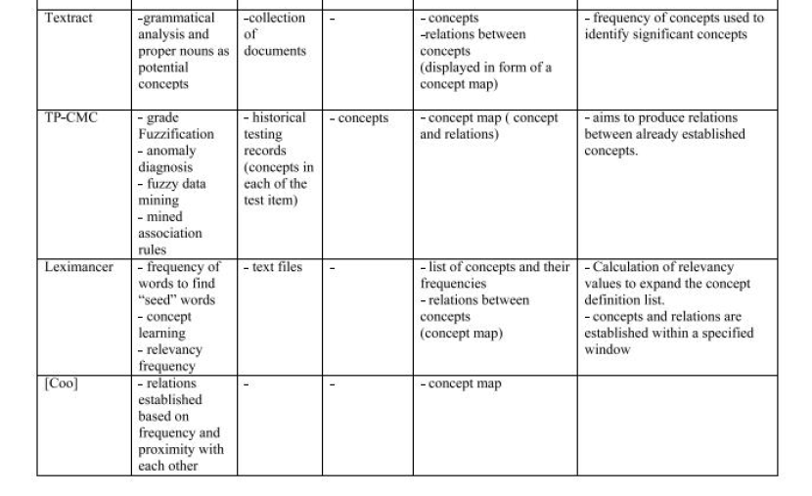
Comparison of tools [Cont.]

Slide 12
Literature Survey-Research Papers

Slide 13
Paper 1[10]:
Title : The Automatic Creation of Concept Maps from Documents Written Using Morphologically Rich Languages
Authors : Krunoslav Zubrinic, Damir Kalpic, Mario Milicevic
Published in : Dept. of Electrical Engineering & Computing, University of Zagreb & University of Dubrovnik

Slide 14
Concept Map Mining
The automatic or semi-automatic creation of CMs from documents is called concept map mining (CMM)
In a semi-automatic process, the system finds and suggests elements of a map, and a person manually has to finish the map using the provided information.
In the automatic construction process, the user's assistance is not required, and the process creates the map automatically from available resources.

Slide 15
Definition of Concept Map
Formally, a hierarchical CM can be defined (Villalon & Calvo 2008) as a set CM={C,R,T}.
C=is a set of concepts . Each concept is a word or phrase, and is unique in C.
R is a set of relationships among concepts. Each relationship , connects two concepts, . Label is a term that labels relationship and represents a conceptual relationship between coupled concepts.
T is a sorted set of hierarchical levels in a CM. Each element corresponds to a set of concepts that share the same level of generalization in a CM.

Slide 16
Concept Map Mining Process
A CMM process can be implemented using NLP methods currently found in tasks supporting information extraction (IE), information retrieval (IR) and automatic summarization.
IE is the process of automatically extracting structured information, such as entities and relations, from unstructured textual sources.
IR is the area concerned with searching for information in documents and metadata about documents
The goal of automatic summarization is to distil content from a source, and present the most important content to the user in a condensed form

Slide 17
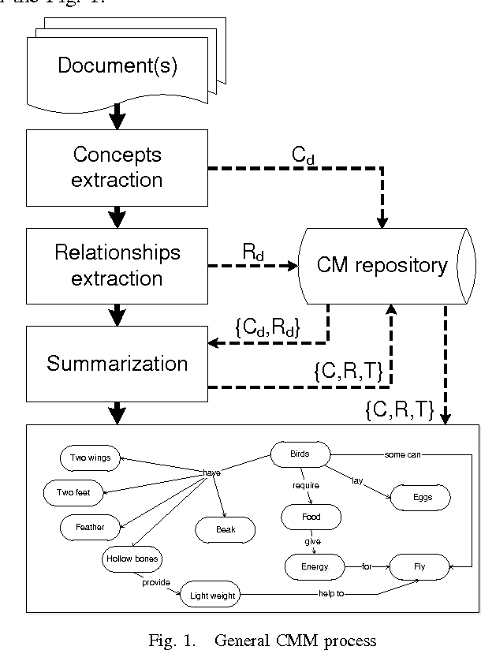
Concept Map Mining Process

Slide 18
Methodology
Methods traditionally used in these areas are rule-based statistical and machine learning methods.
More recently, there has been interest in combining finite-state machines with conditional-probability models, e.g. maximum entropy Markov models and conditional random fields.

Slide 19
Methodology [Cont.]
Statistical methods are used for analyze the frequency of terms and their co-occurrence in a document.
Machine learning methods base their functionality on both supervised and unsupervised learning. The “learned” information is used for extraction of concepts and relationships from unknown data. Ex-TEXCOMON (software tool. This application uses a simple Kea algorithm based on a naïve Bayes classifier.

Slide 20
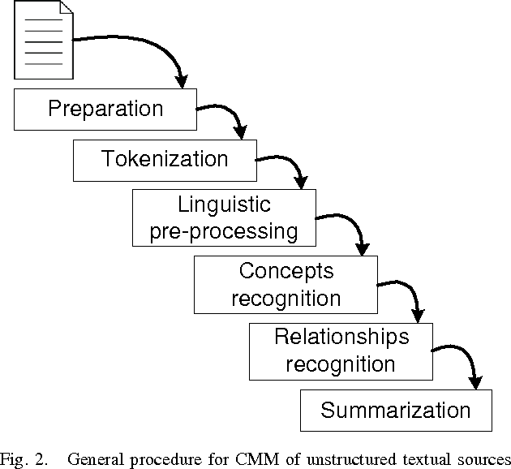
Methodology [Cont.]

Slide 21
Conclusion
A fully automatic production of a human-quality CM from a given document is difficult and has not yet been satisfactorily resolved. It is not enough just to extract words from a document; one must also identify and label relevant concepts and relationships among them.
One of goals that we shall try to achieve in this research is to create a system that is applicable as a real-time operation. This means that precision may be sacrificed for a better and faster response time.

Slide 22
Paper 2[11]:
Title : Automatic Construction of Concept Maps
Authors : Belinda Ng’asia Wafula
Published in : University of Eastern Finland, Faculty of Science & Forestry, Joensuu School of Computing
Year : May 2016

Slide 23
Types of Concept Maps
Types of concept maps are viewed from two extremes; hierarchical or tree-structured maps and mind maps.
They are constructed in a tree-like manner, with the more general concepts at the top of the map and the more specific concepts hierarchically at the bottom of the map.
On the other hand, mind maps are constructed freely from a key idea, allowing any kind of association.

Slide 24
An Automatic Concept Map Constructor
The main processes involved in ACMC is the extraction of words from the text, significant concepts, and extraction of potential relations between the extracted concepts.
The basic method used in ACMC to extract concepts is term occurrence. No syntactic analysis, auxiliary ontologies or other resources are needed by ACMC to extract concepts.

Slide 25
As Input, ACMC requires a number of external data sources in the construction of the concept map. ACMC requires a file containing the text material in which to extract concepts and relations. ACMC requires two additional files.
One containing a list of stop words. Stop words are words that are so common that they are useless to index. ACMC uses this file to access the stop words that will be eliminated from the list of extracted words.
The second file contains a list of identified irregular plurals and their corresponding singular.Examples-live,children,criteria etc.
An Automatic Concept Map Constructor[Cont.]

Slide 26
Extract words from a given text.
Calculate the frequencies of the extracted words.
Remove stop words.
Merge plurals and singular forms of words.
Prune infrequent words.
Steps
Construct compound words.
Calculate the frequencies of compound words.
Find relations between concepts in a sentence.
Prune infrequent relations.
Display the map.

Slide 27
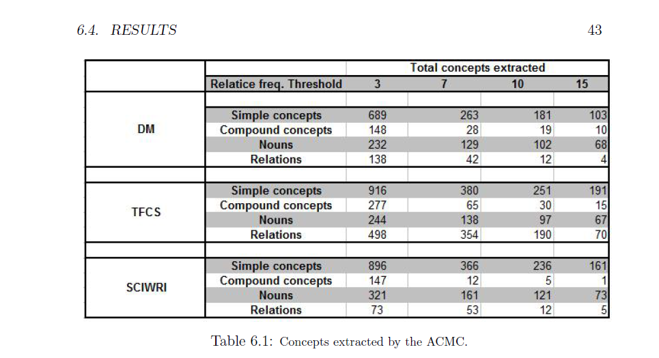
Results

Slide 28
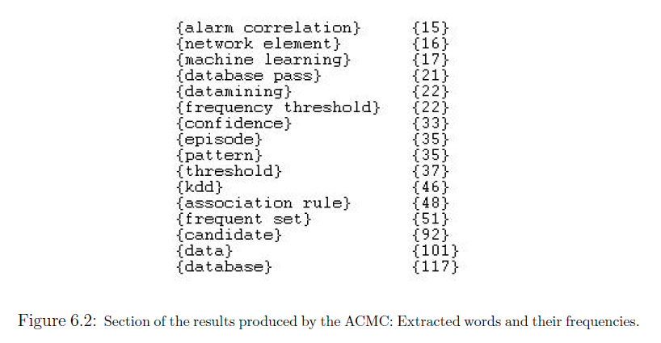
Results

Slide 29
Conclusion
In general, it is difficult for an individual to construct an effective concept map as the concept maps vary from one individual to another.
The individual's understanding and perspective of the subject concerned accounts for the variations of concept maps of the same subject.
Our experiments suggest that the method can select well relevant concepts and especially compound concepts, but the extraction of relevant relations would require further research.

Slide 30
Paper 3[8]:
Title : Concept Maps Mining for Text Summarization
Authors : Camila Zacche’de Aguiar
Published in : Federal University of Espirito Santo, Brazil
Year : March 2017

Slide 31
Methodology
Extract topic
Extract entities & relation
Ordering properly
Label relationship

Slide 32
Text Mining

Slide 33
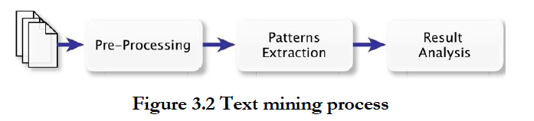
Text Mining Process

Slide 34
Pre-Processing Tasks

Slide 35
Information Extraction (IE)
Used to identify some relations between that are asserted between two entities.
Morphological
Analysis
Syntactical
Analysis
Semantic
Analysis

Slide 36
Paper 4[9]:
Title : The Stanford CoreNLP Natural Language Processing Toolkit
Authors : Christopher D. Manning, Mihai Surdeanu, John Bauer,
Jenny Finkel, Steven J. Bethard, David McClosky
Published in : Stanford University, California.

Slide 37
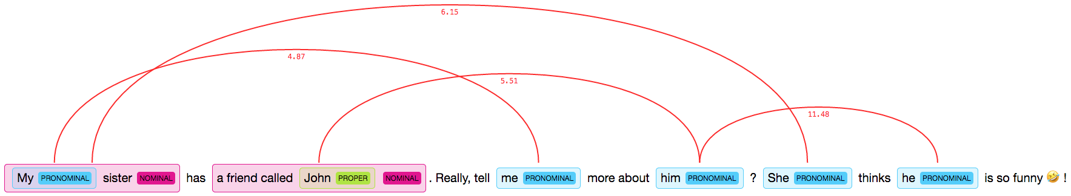
Coreference Resolution

Slide 38
Coreference Resolution [Cont.]
It’s the journey from tokenizing to coreference resolution.

Slide 39
Coreference Resolution - Advantages
Quick Response.
Easy to use.
To provide lightweight framework using plain java objects.
To provide a simple concrete API.

Slide 40
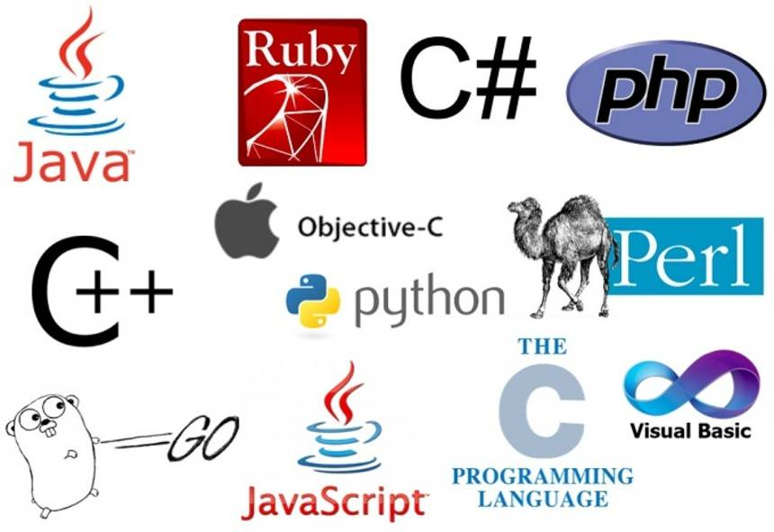
StanfordCoreNLP – The Big Advantage

Slide 41
Coreference Resolution - The whole process
Tokenize
cleanxml
Ssplit
Pos
Lemma
Ner
Parse
Sentiment
Dcoref

Slide 42
StanfordCoreNLP – Human Language Support

Slide 43
Our Approach
Textual Input
Neural
Coref
Text file
Sentence Tokenization
Word Tokenization
Grammar Extraction
Logic Forming
Map Creation
Concept Map Creation
Coreference resolution

Slide 44
Example - Coreference Resolution
Input:-
An array is a collection of element having same data-type but it is static in nature. ArrayList is a part of collection framework and is present in java.util package. It provides us dynamic arrays in Java. it inherits AbstractList class and implements List interface. it allows us to randomly access the list.
Output:-
An array is a collection of element having same data-type but An array is static in nature. ArrayList is a part of collection framework and is present in java.util package. ArrayList provides us dynamic arrays in Java. ArrayList inherits AbstractList class and implements List interface. ArrayList allows us to randomly access the list.

Slide 45
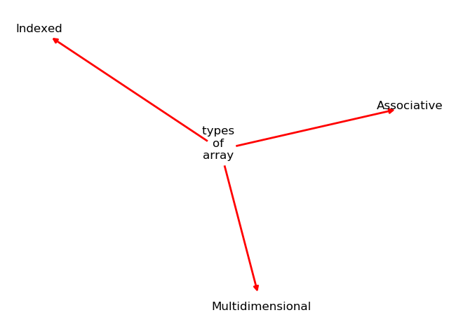
Example – Sentence 1
Input:-
There are three types of array Indexed, Associative and Multidimensional.
{'There': 'EX', 'are': 'VBP', 'three': 'CD', 'types': 'NNS', 'of': 'IN', 'array': 'NN', 'Associative': 'NNP', ',': ',', 'Multidimensional': 'NNP', 'and': 'CC','Indexed':'NNP'}
Output:-

Slide 46
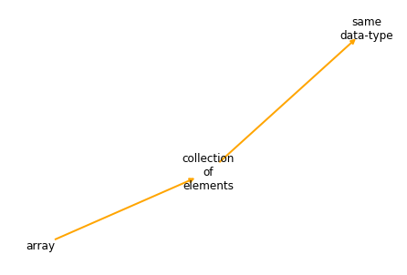
Example – Sentence 2
Input:-
Array is collection of elements having same data-type.
{'Array': 'NNP', 'is': 'VBZ', 'collection': 'NN', 'of': 'IN', 'elements': 'NNS', 'having': 'VBG', 'same': 'JJ', 'data-type': 'JJ'}
Output:-

Slide 47
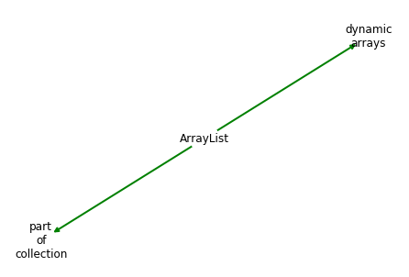
Example – Sentence 3
Input:-
ArrayList is part of collection framework and is present in java.util package. ArrayList provides dynamic arrays in Java.
{'ArrayList': 'NNP', 'is': 'VBZ', 'part': 'NN', 'of': 'IN', 'collection': 'NN', 'framework': 'NN', 'and': 'CC', 'present': 'JJ', 'in': 'IN', 'java.util': 'JJ', 'package': 'NN', 'provides': 'VBZ', 'dynamic': 'JJ', 'arrays': 'NNS', 'Java': 'NNP', '.': '.'}
Output:-

Slide 48
Possible Enhancements
Aim is to create concept map of a whole chapter of any book that summarizes the main idea of the chapter.
We look to combine rule based method with statistical analysis and logic based formation to create a generic domain based concept map

Slide 49
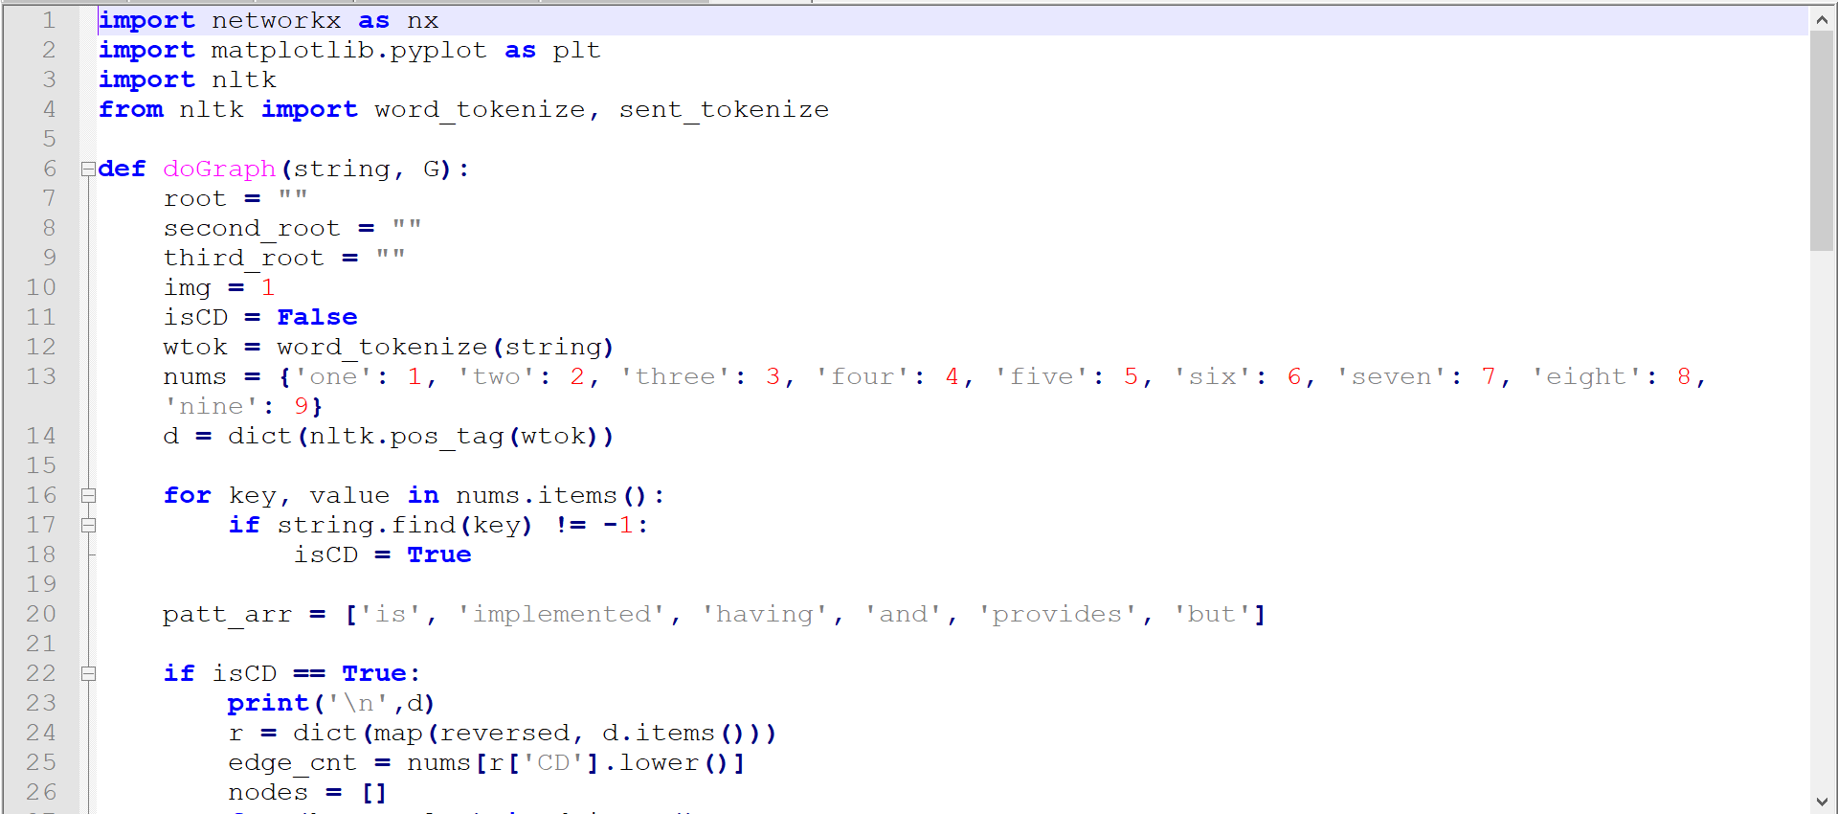
Implementation :-

Slide 50
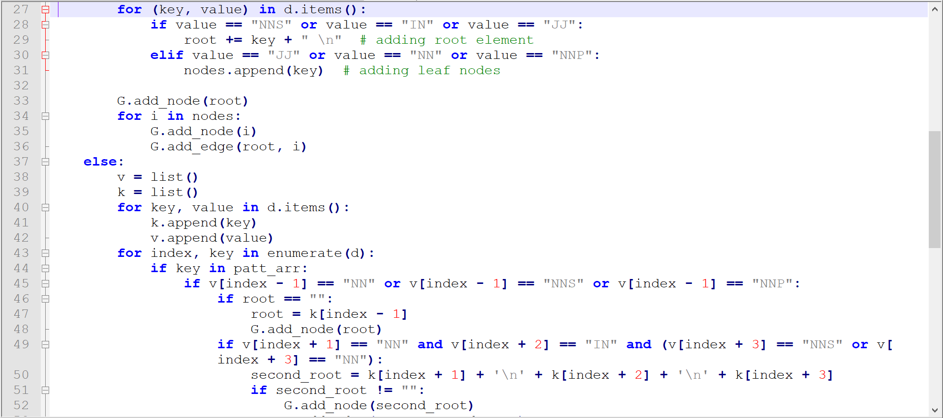
Implementation[Cont.] :-

Slide 51
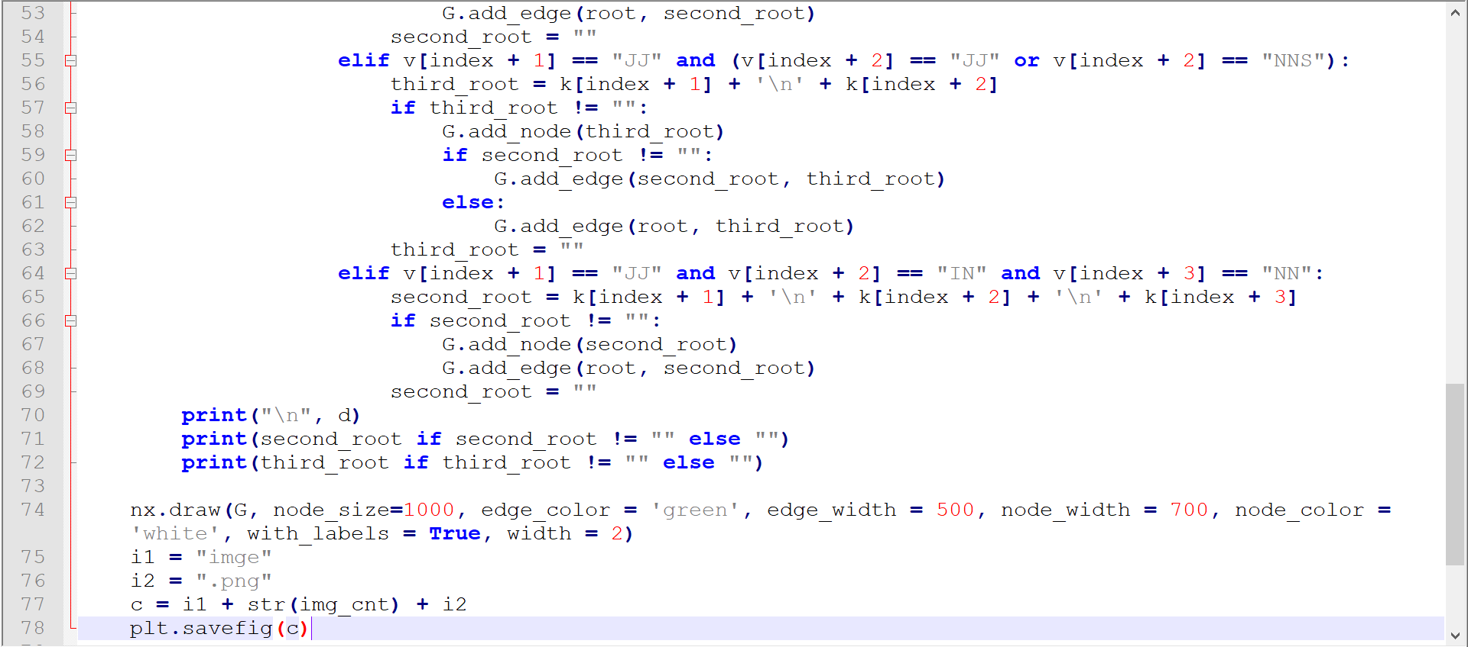
Implementation[Cont.] :-

Slide 52
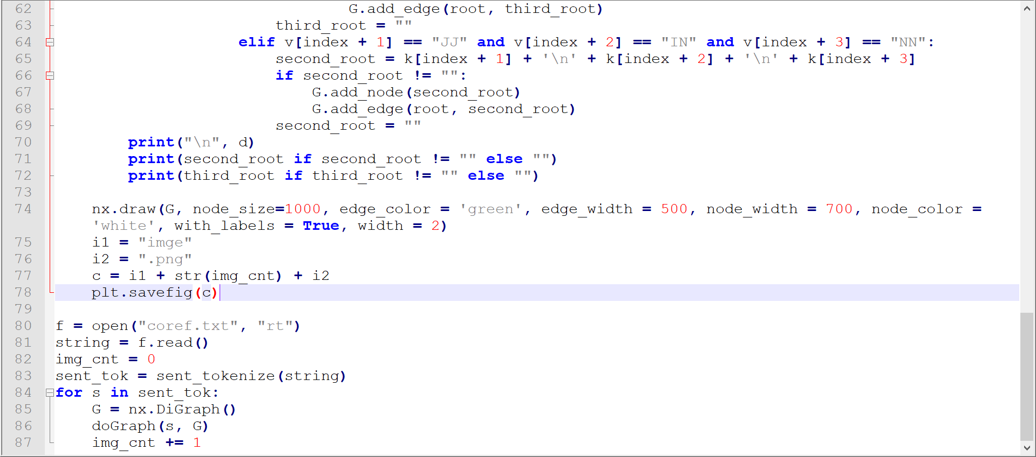
Implementation[Cont.] :-

Slide 53
Code Links
Link for the Coreference Resolution
https://github.com/Hardikraja/stanfordCoreNLP
Link for the Concept Map Creation code
https://github.com/messihenil/dis_python.git

Slide 54
References
https://tobloef.com/text2mindmap/
https://www.mindmup.com/
https://www.mindmeister.com/
https://www.ayoa.com/
https://www.mindlyapp.com/
https://www.smartdraw.com/
https://stormboard.com/
http://portais4.ufes.br/posgrad/teses/tese_11160_CamilaZacche_dissertacao_final.pdf
https://stanfordnlp.github.io/CoreNLP/
https://www.semanticscholar.org/paper/Automatic-creation-of-a-concept-map-Zubrinic-Cari%C4%87a/a44fc3874a60b9e3feb363de54c28a9d3153c14d
http://epublications.uef.fi/pub/urn_nbn_fi_uef-20160829/urn_nbn_fi_uef-20160829.pdf

